Slide 1

T3 -Linear Boost
Sit Dolor Amet

Slide 2
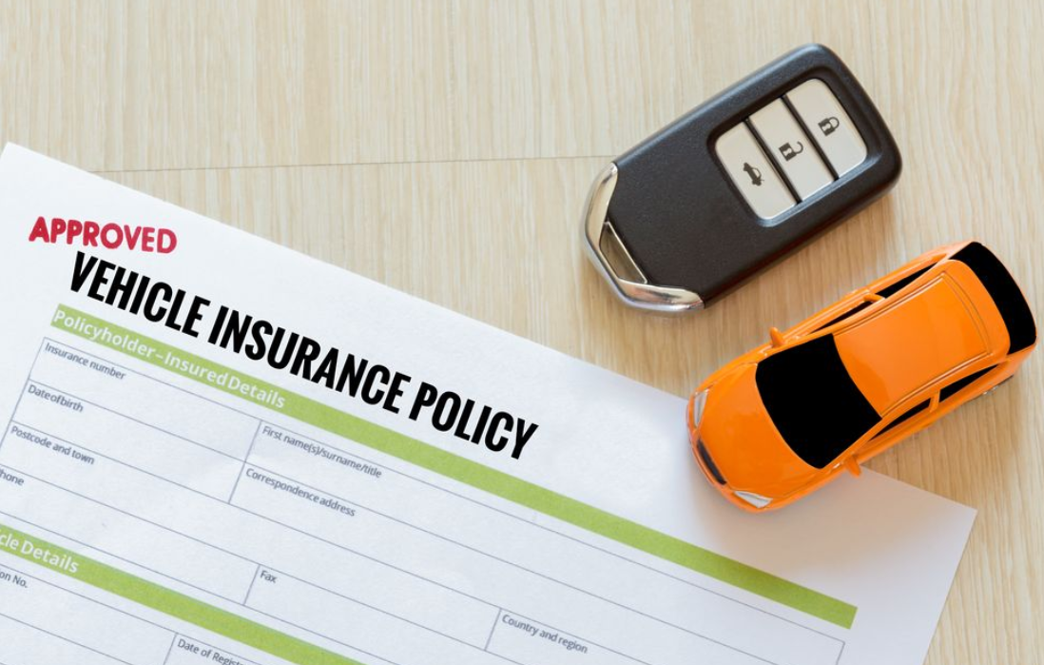
Smart Question
Which factors suggest whether a customer would be interested in vehicle insurance?

Slide 3
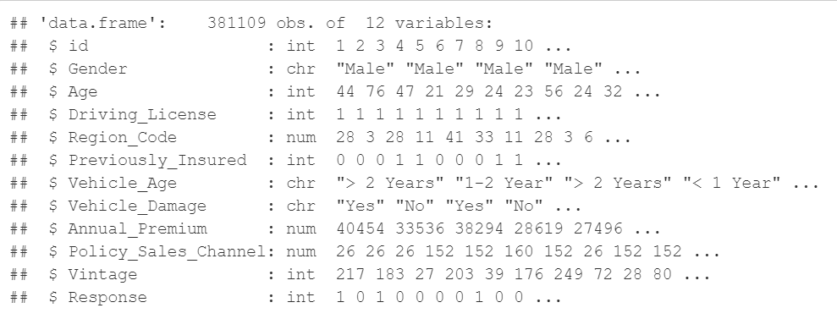
About the Dataset

Slide 4

Exploratory Data Analysis

Slide 5
For the EDA
● Turn the variables of ‘Response’, ‘Driving_License’ and ‘Previously_Insured’ into factor
● Removed outliers from variable ‘Annual_Premium’
● Subsetted the data used for to obtain the correlation indicator
● Graphs used:
Histogram
QQ-plot
Boxplot

Slide 6
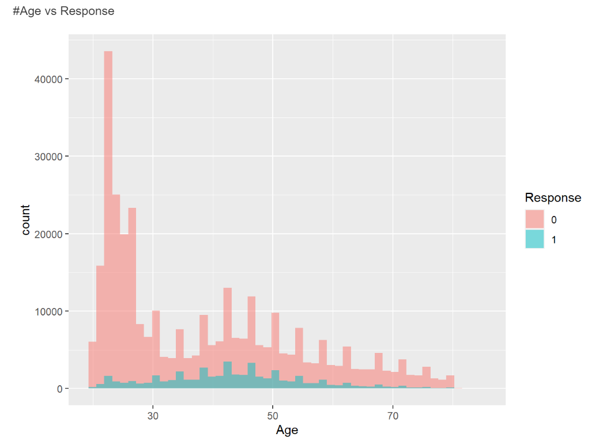
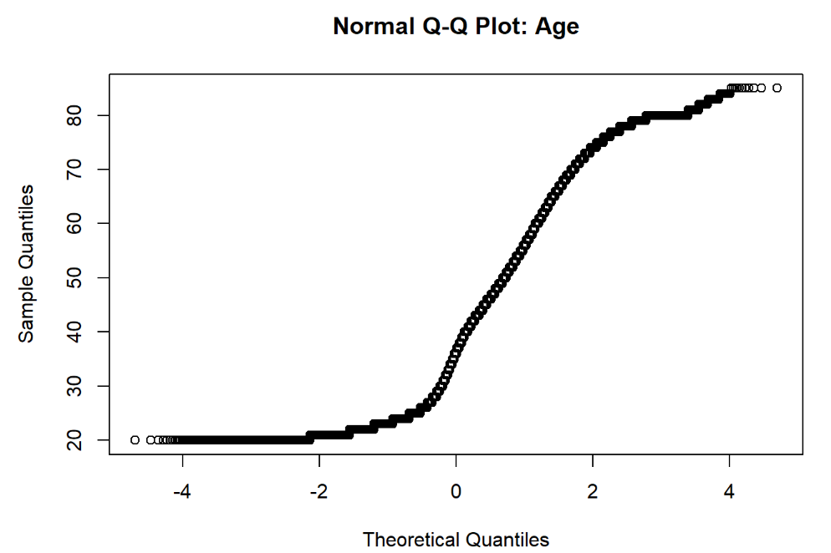
Age histogram and QQ plot

Slide 7
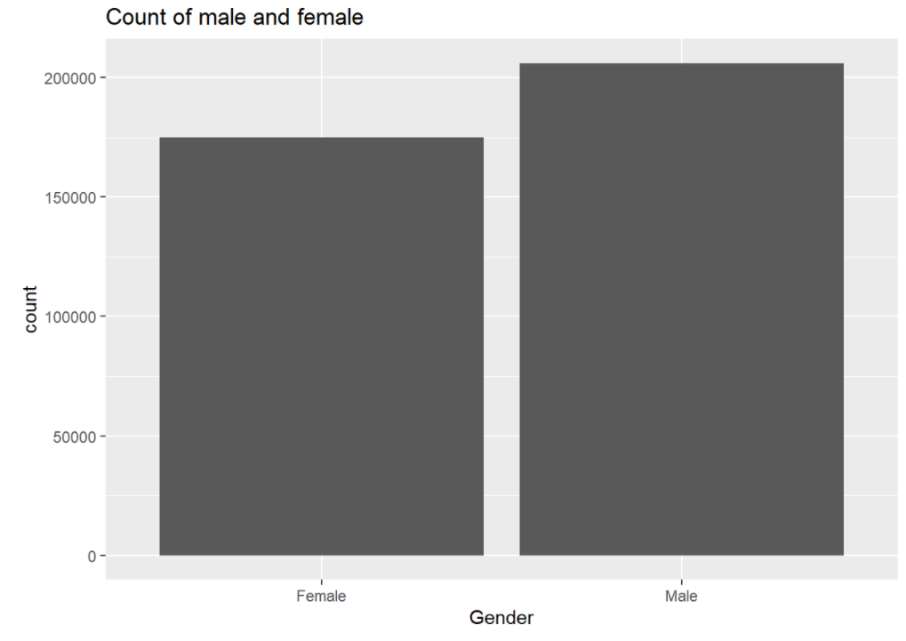
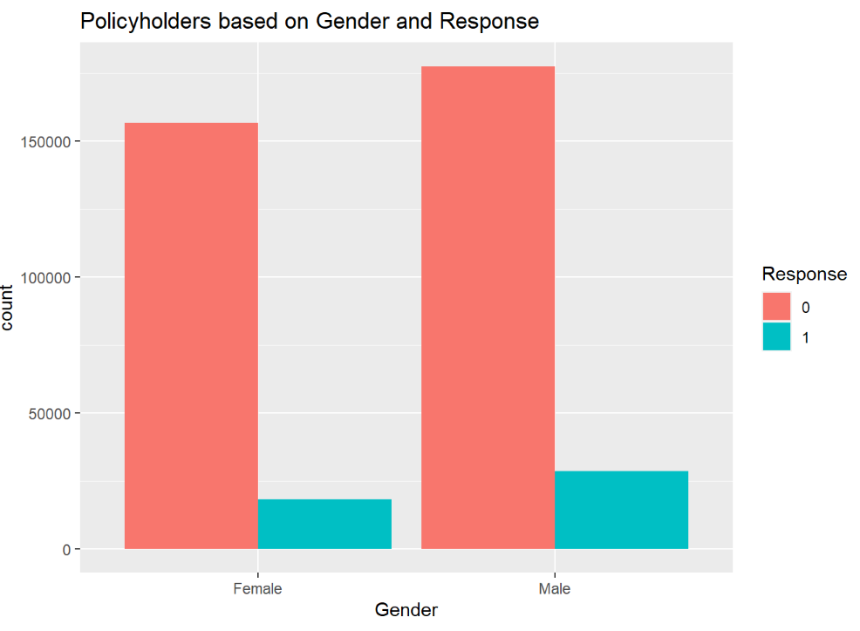
Histograms: Gender and Gender by Response

Slide 8
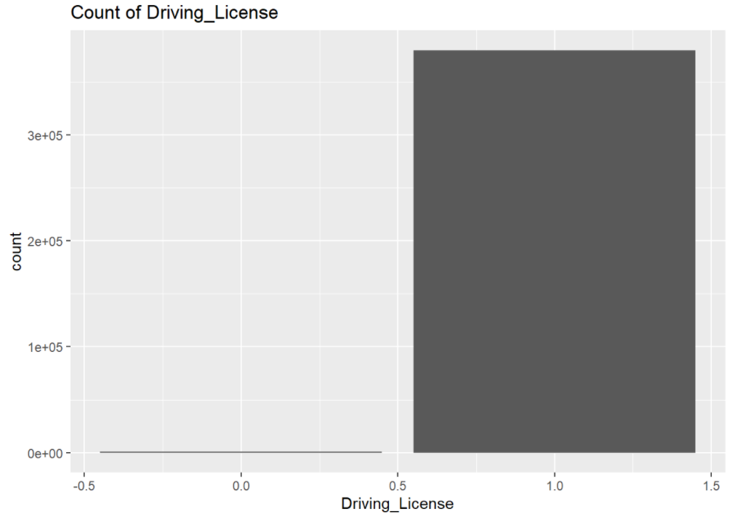
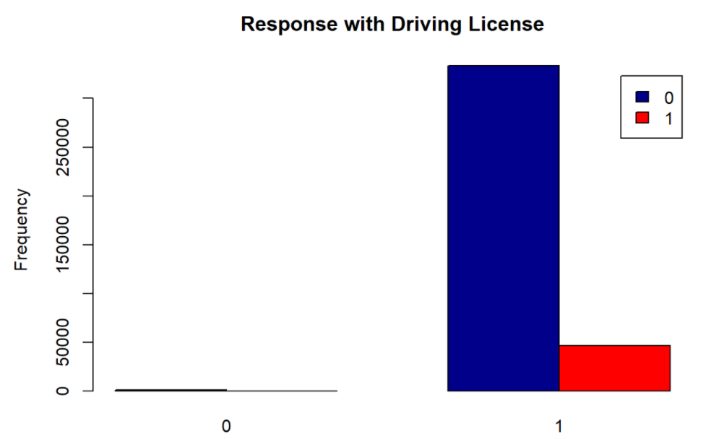
Histogram: Driving License and Driving License by Response

Slide 9
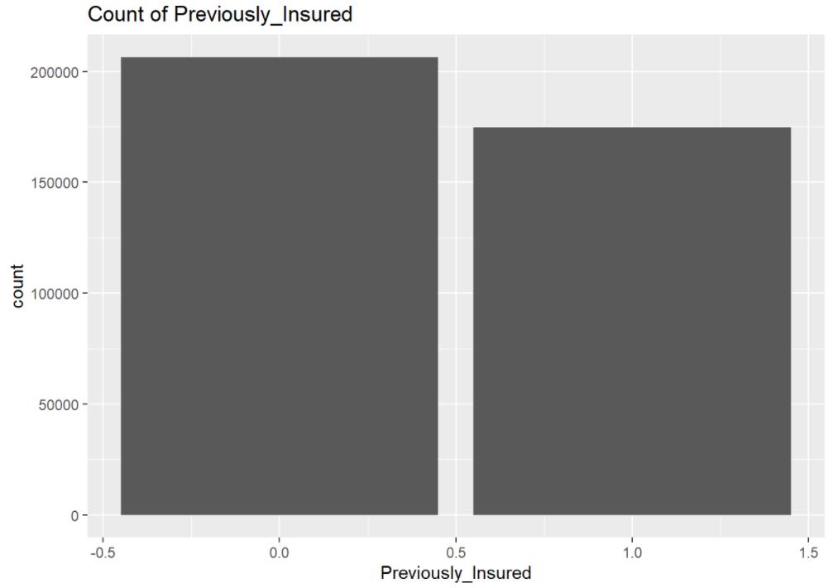
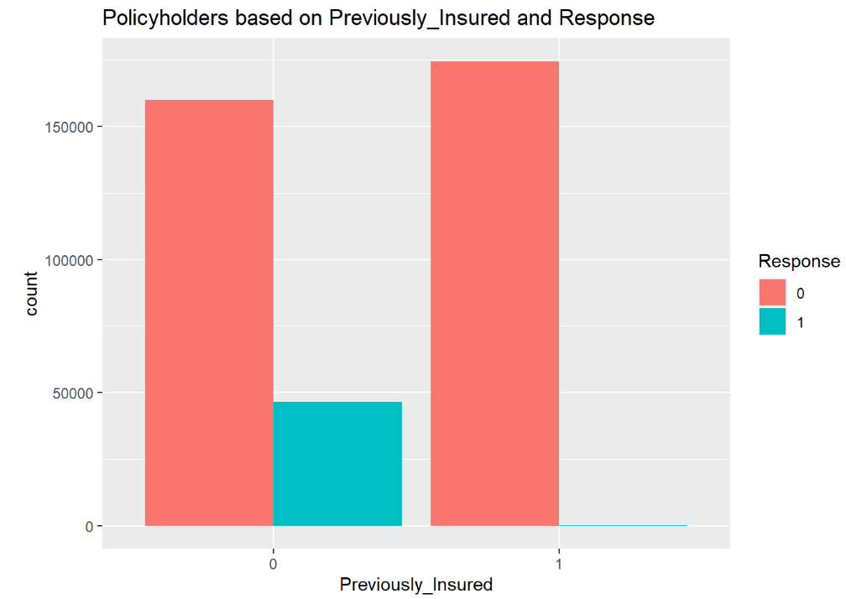
Histogram: Previously Insured and Previously Insured by Response

Slide 10
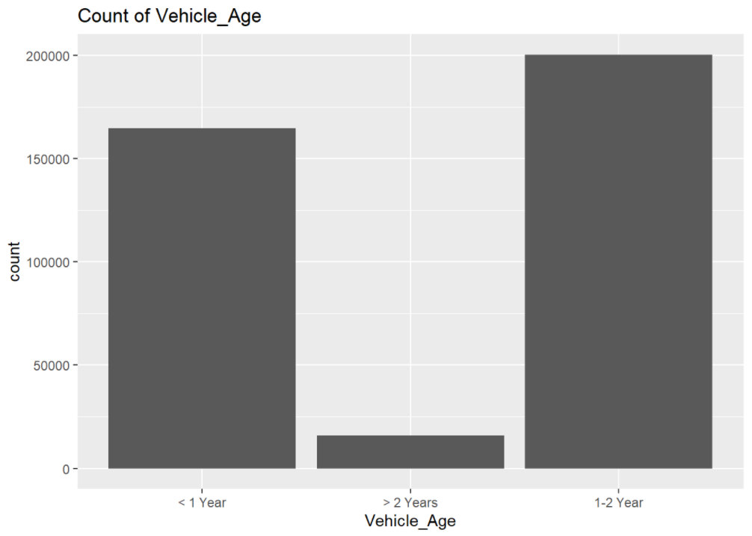
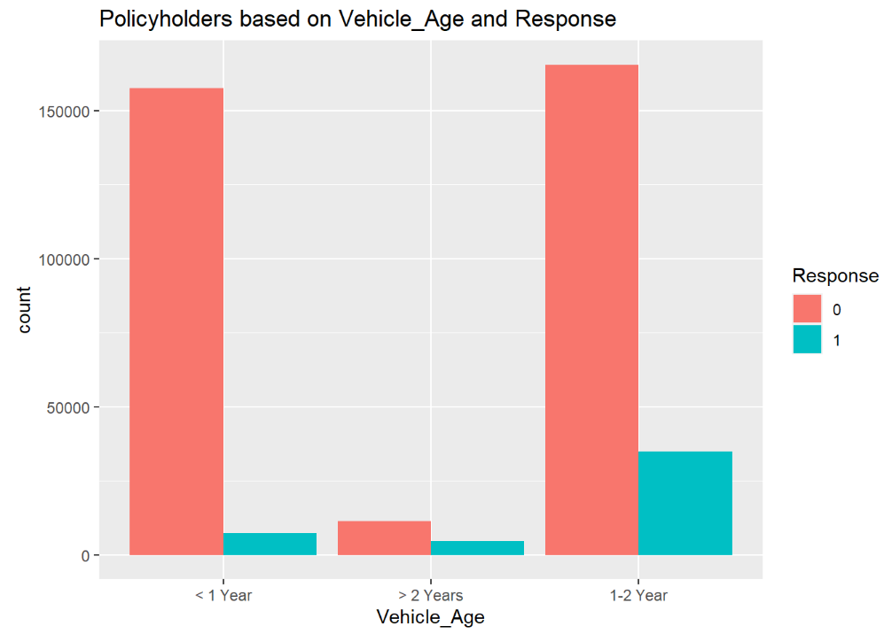
Histogram: Vehicle age and Vehicle age by Response

Slide 11
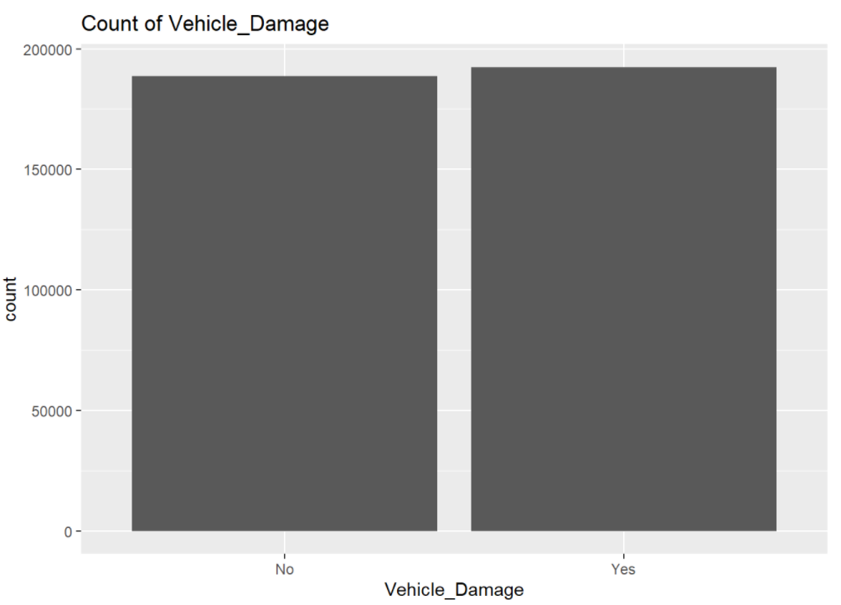
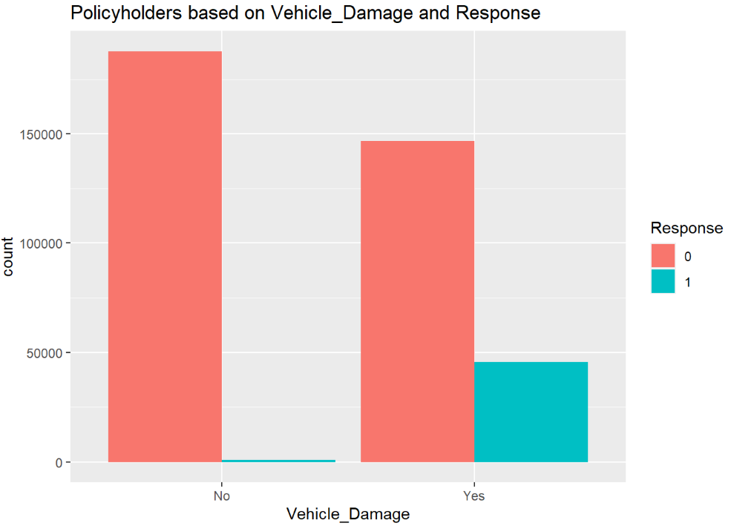
Histogram: Vehicle damage and Vehicle damage by Response

Slide 12
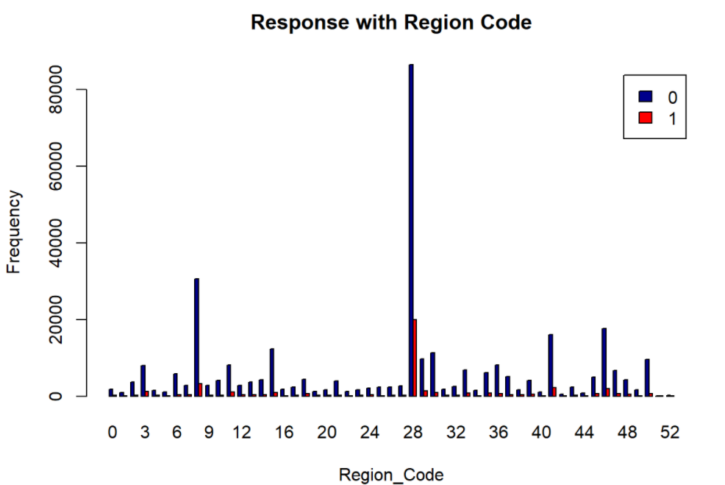
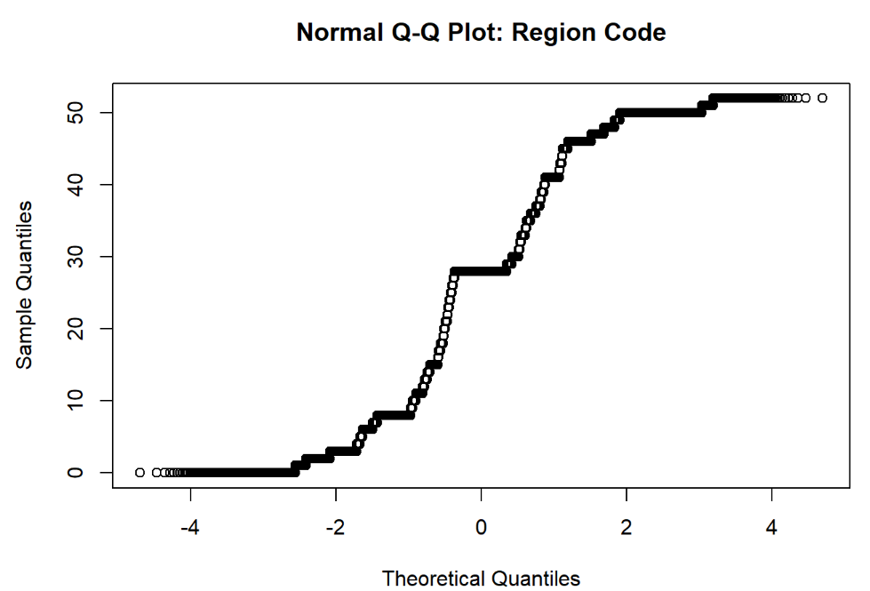
Region code histogram and QQ plot

Slide 13
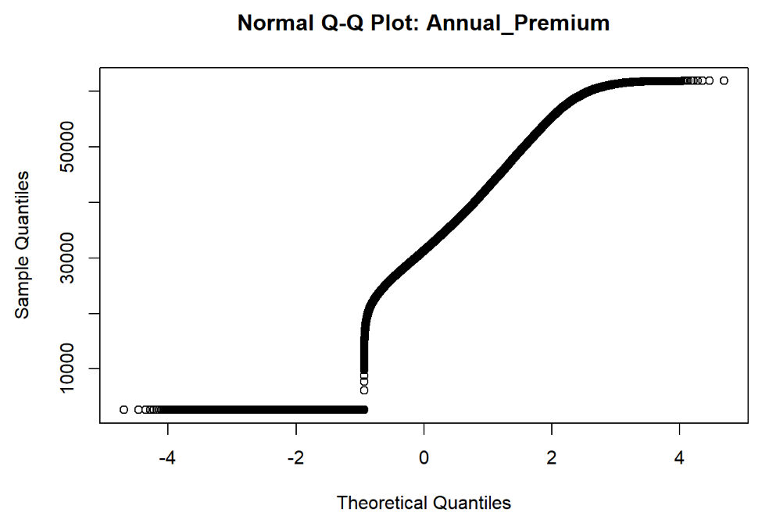

Slide 14
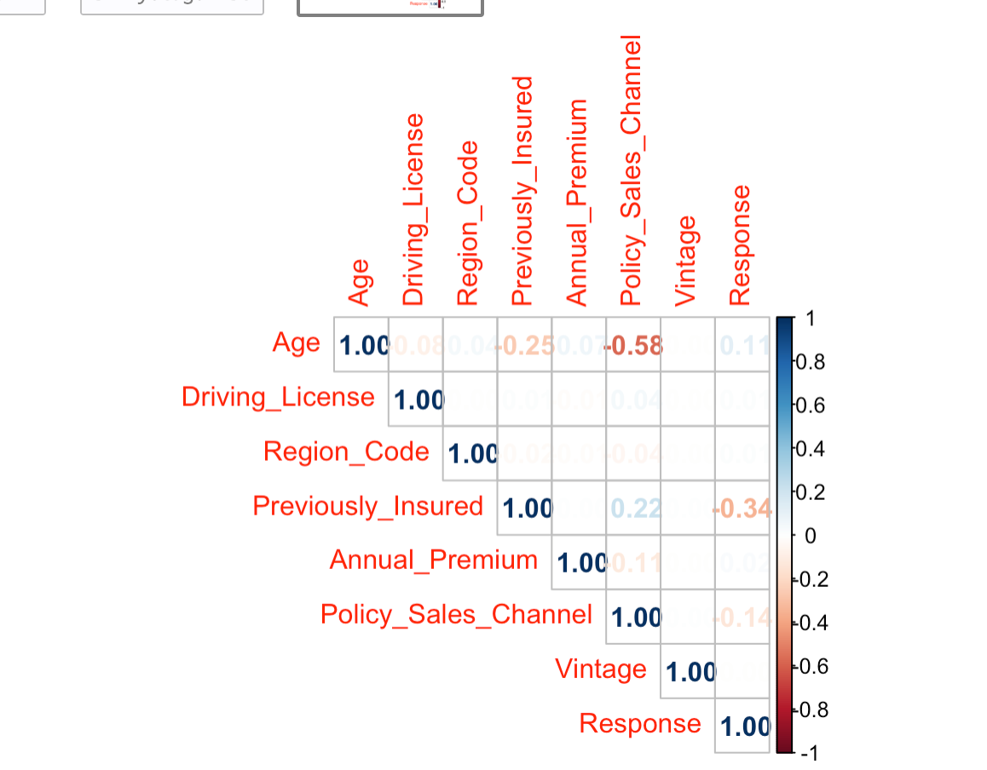
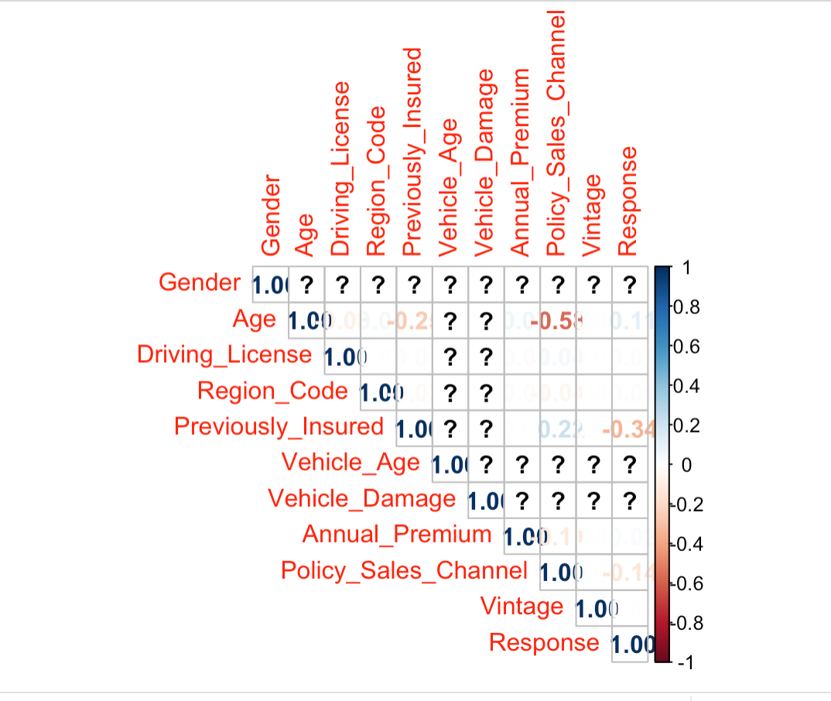
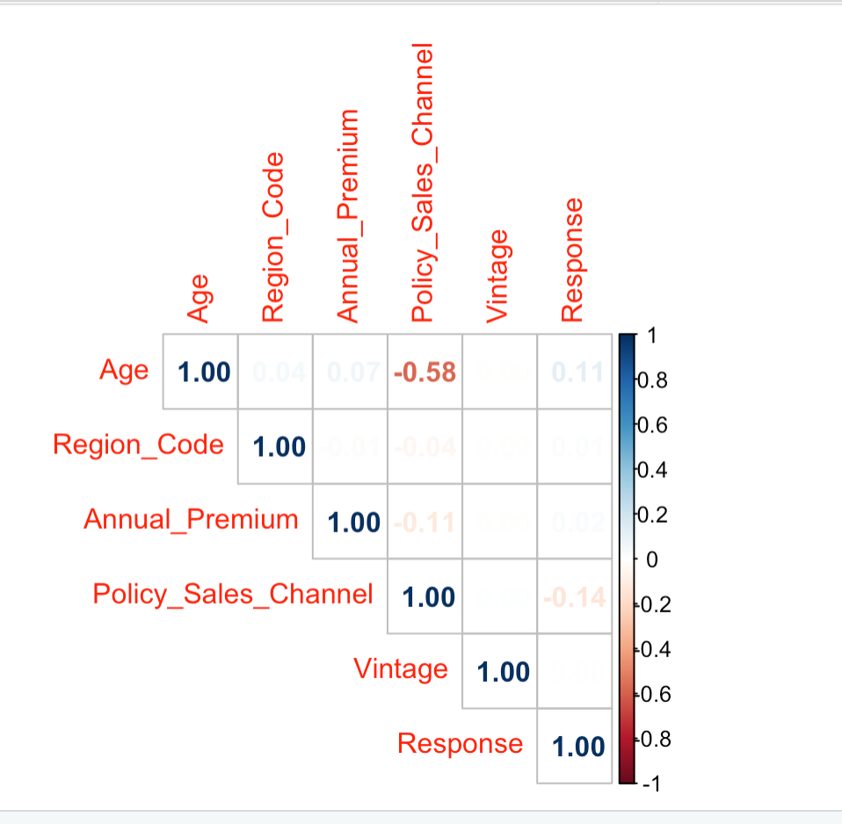
Correlation
1)Correlation between the numerical variables
2)Correlation between the whole variables
3)Correlation after assigned some variables as factors

Slide 15
Questions?

